Slide 1
SQL PROJECT ON Diabetes
FROM KAGGLE
SWATI BIRADAR

Slide 2
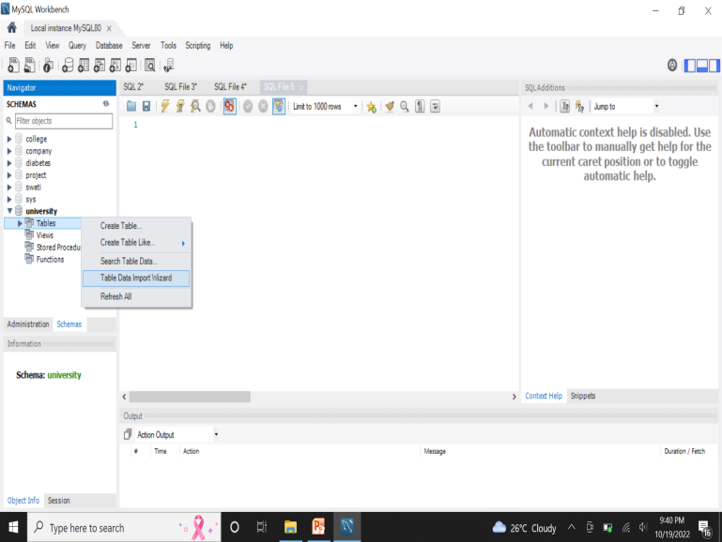
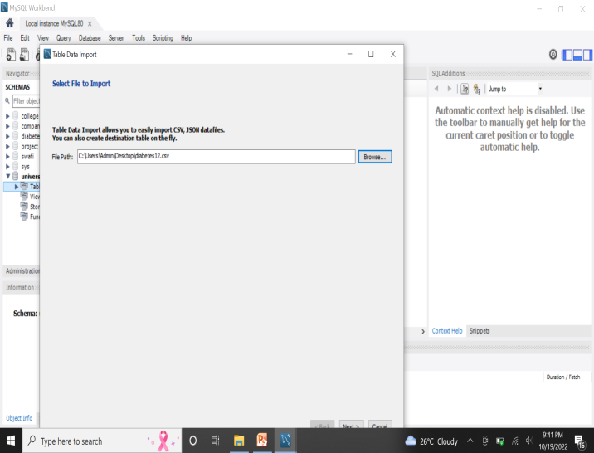
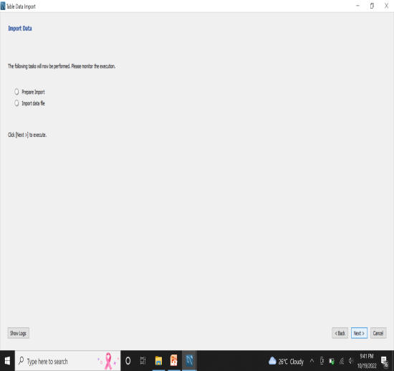
HOW TO IMPORT THE DATABASE TO MYSQL WORKBENCH
Step 1: create a database in My SQL workbench
Step 2: use the database
Step 3: go to the schemas section and right click on tables-> select table data import wizard
Step 4:click one next till it is finished

Slide 3
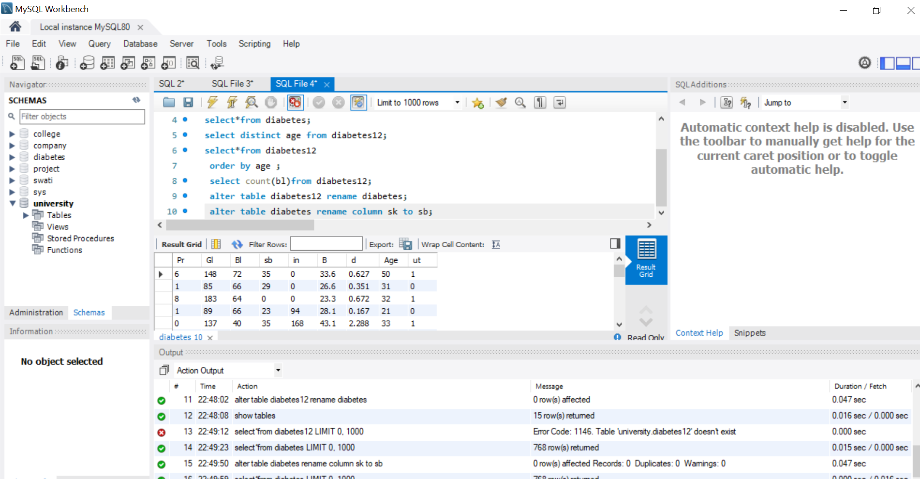
TO SEE THE IMPORTED TABLE DIABETES IN MYSQL WORKBENCH

Slide 4
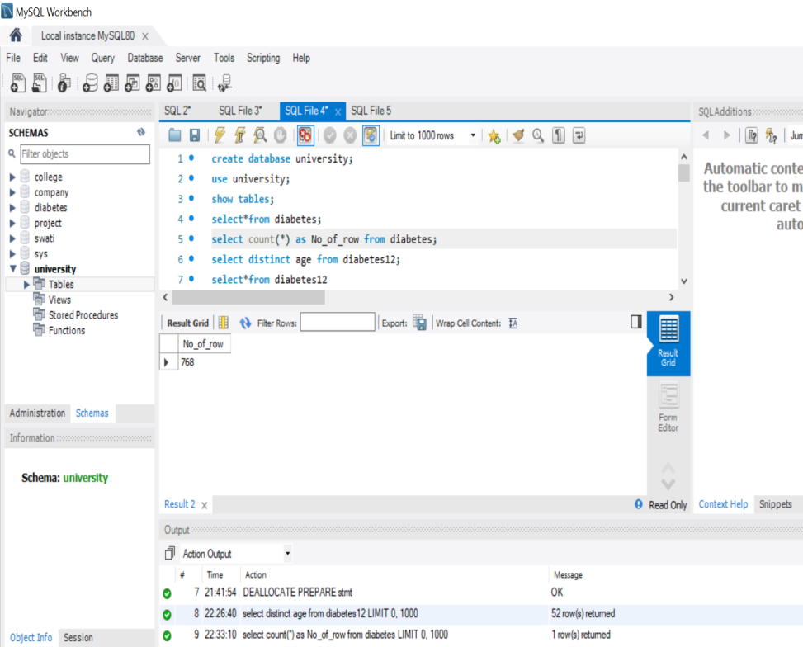
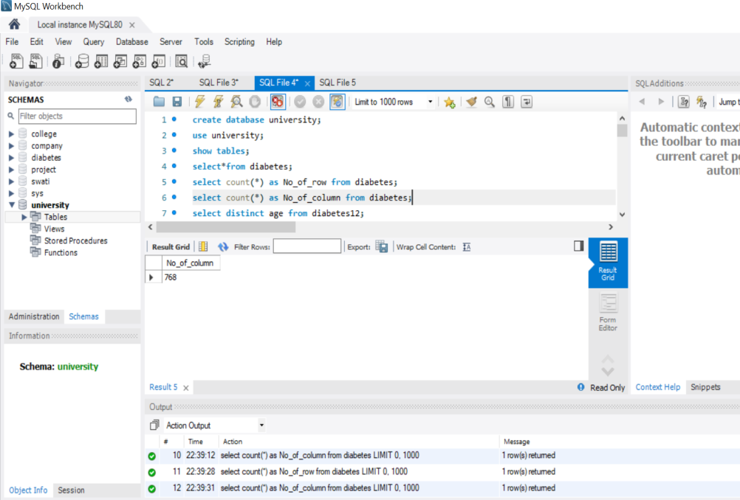
TO FIND NUMBER OF ROWS IN THE DATASET
Number of rows=768
Number of column=9

Slide 5
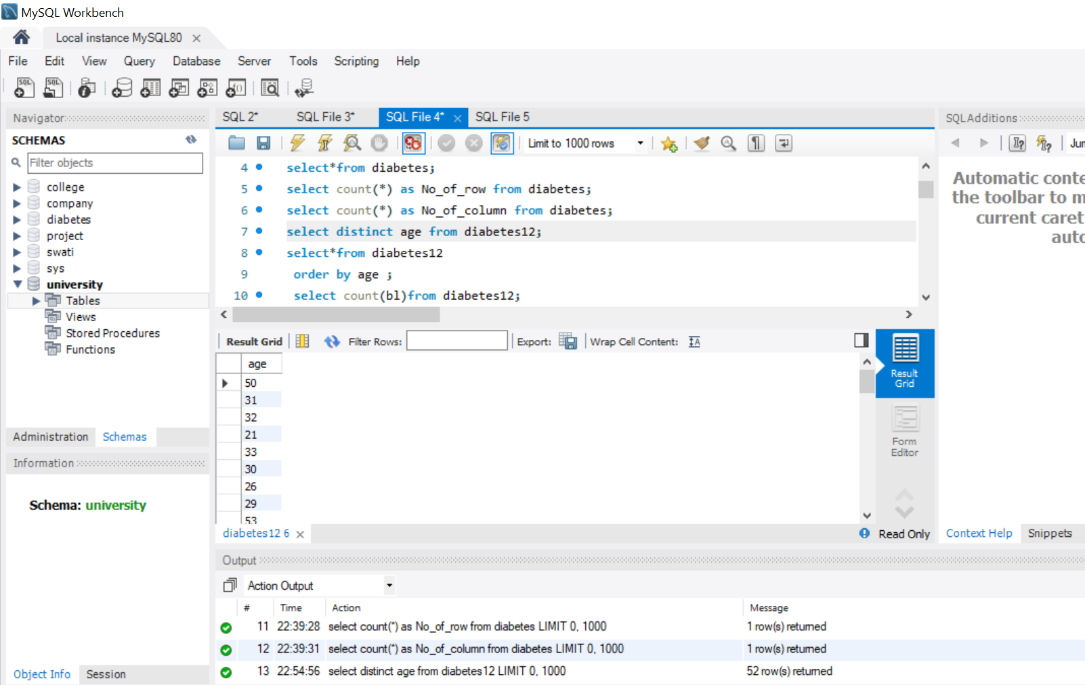
TO VIEW AGE
To use command distinct in the dataset only show the age column

Slide 6
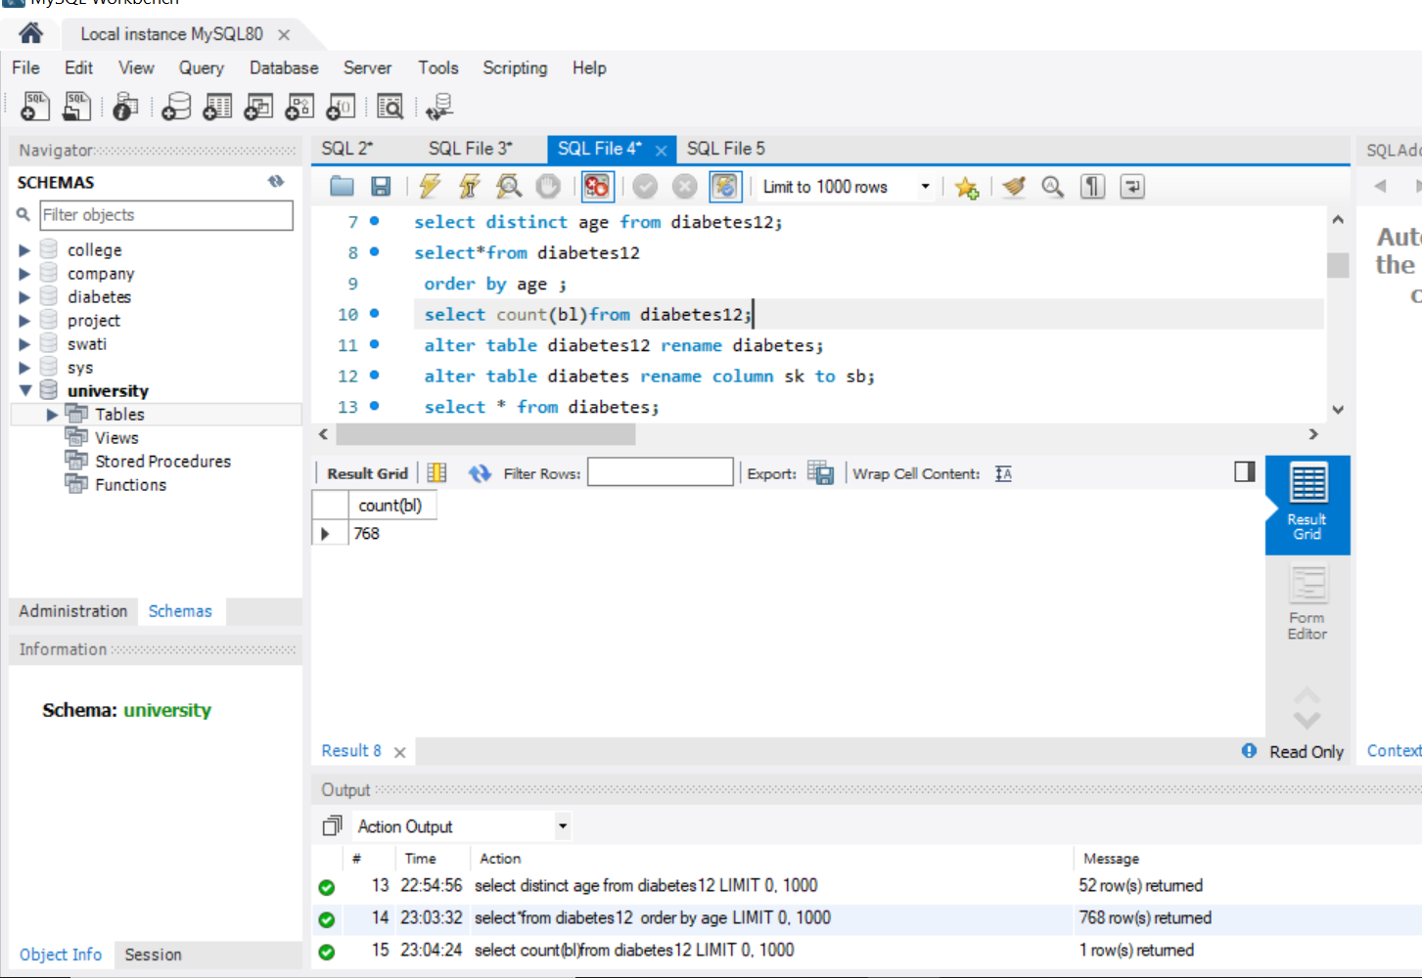
TO FIND THE TOTAL COUNT DATA
To use count command check the total count of column

Slide 7
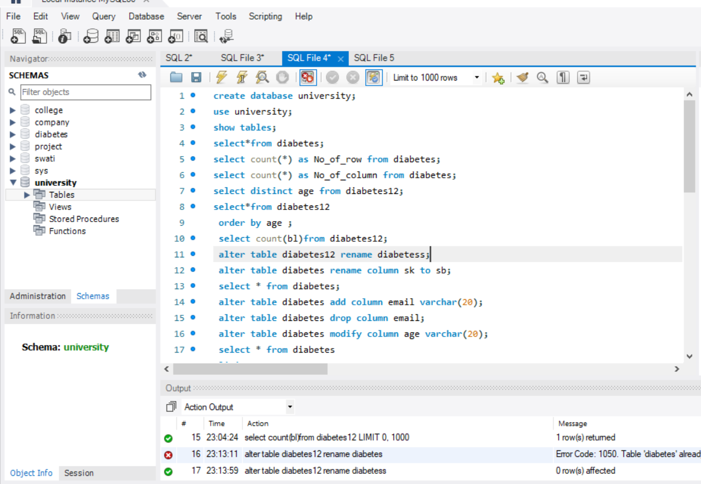
TO RENAME TABLE NAME DIABETES12 TO DIABETESS
Rename table name

Slide 8
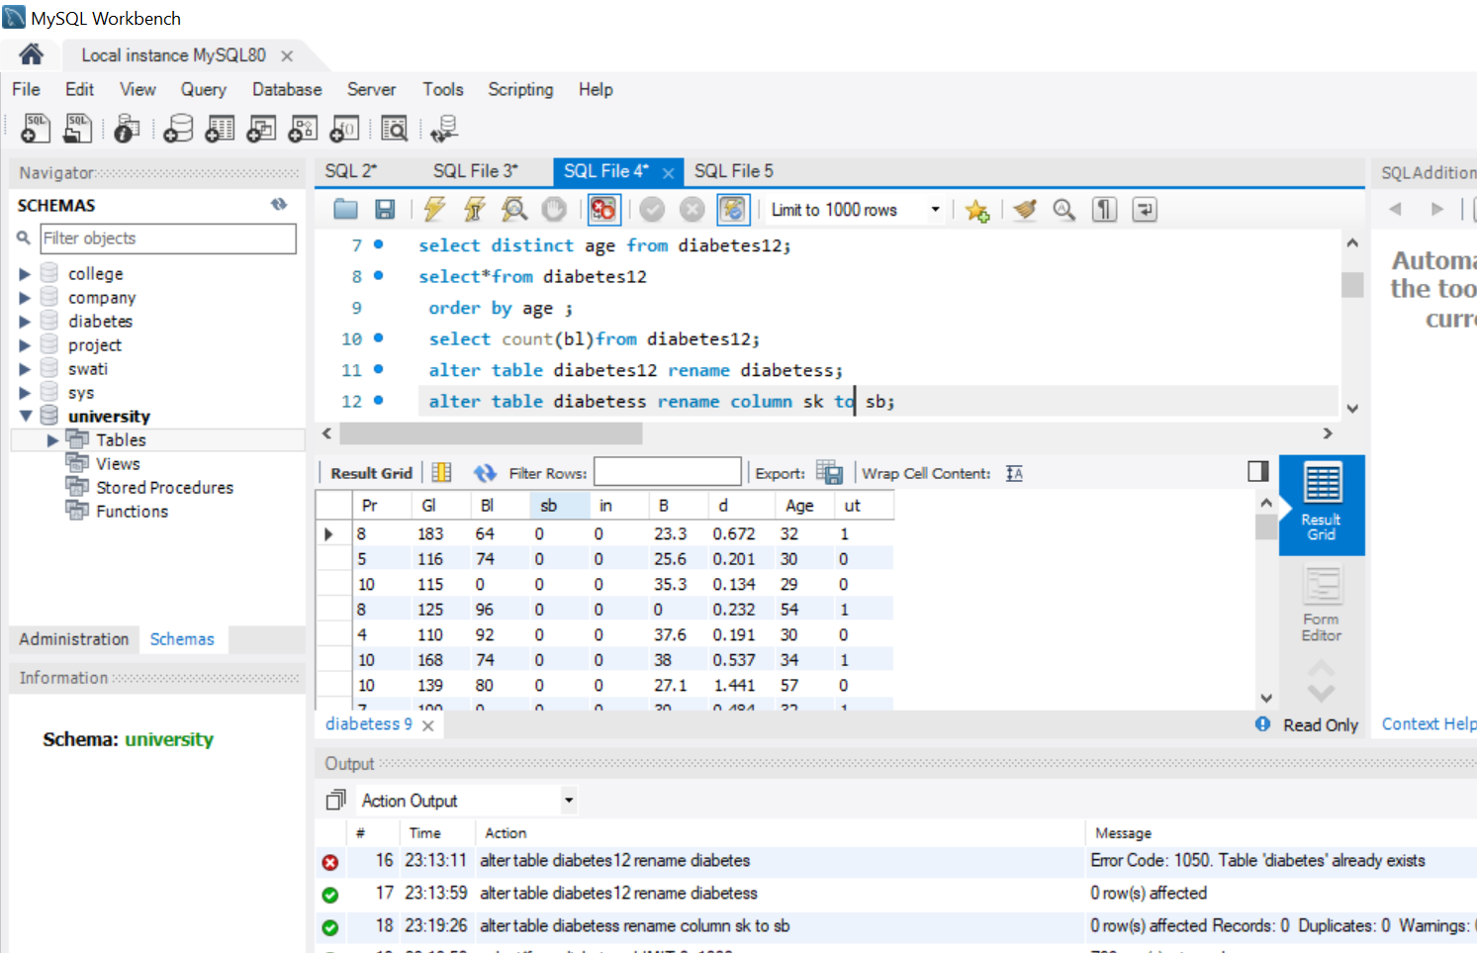
TO RENAME COLUMN NAME PR TO PB
To change column name in table

Slide 9
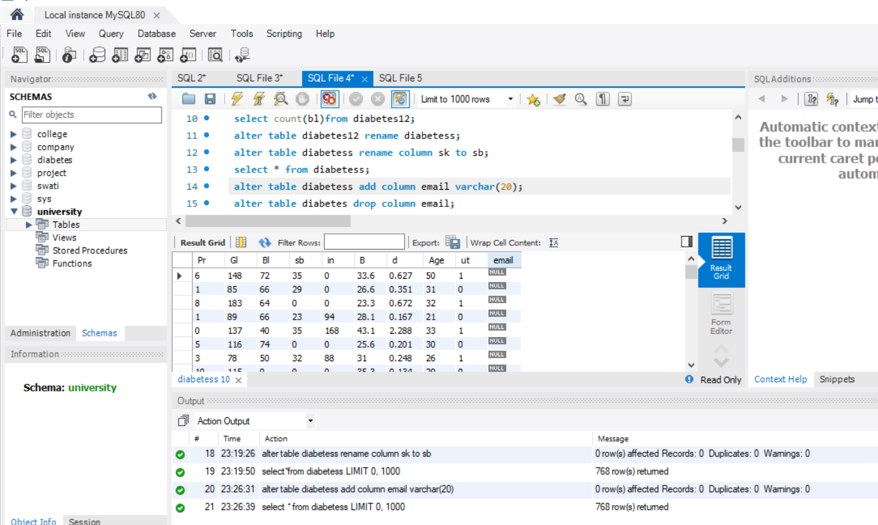
TO ADD COLUMN EMAIL
Add column in the table email

Slide 10
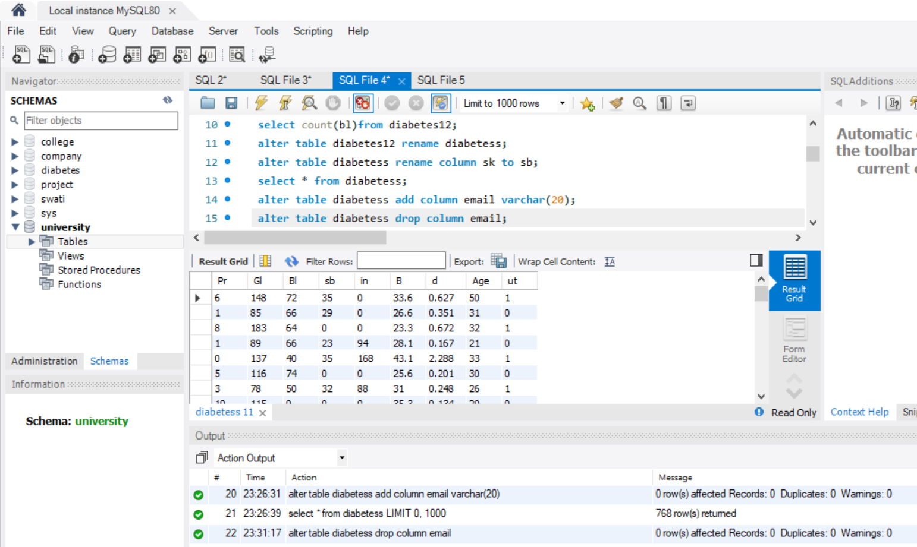
TO DROP COLUMN EMAIL
Drop column email in the table

Slide 11
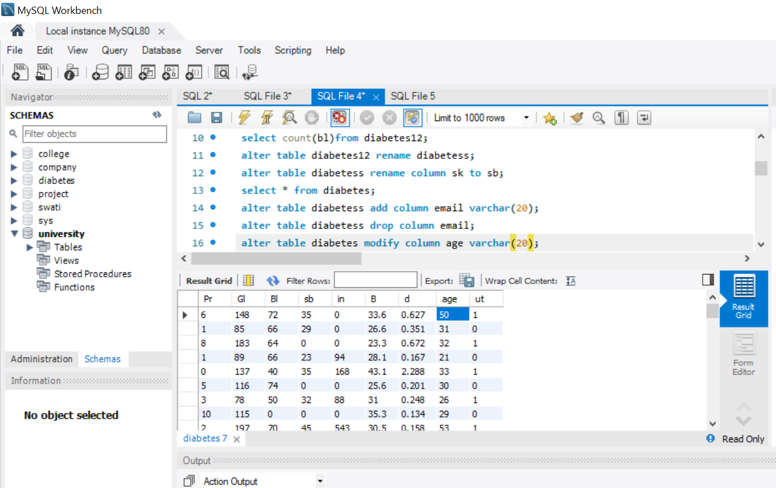
TO MODUFY COLUMN AGE
Modify age column

Slide 12
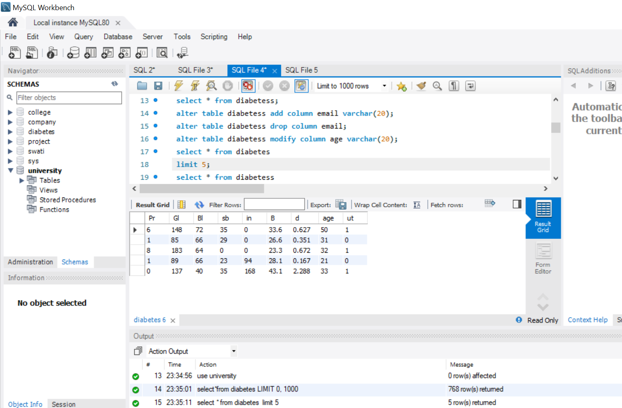
TO SET THE LIMIT 5
Only display 5 rows in the table

Slide 13
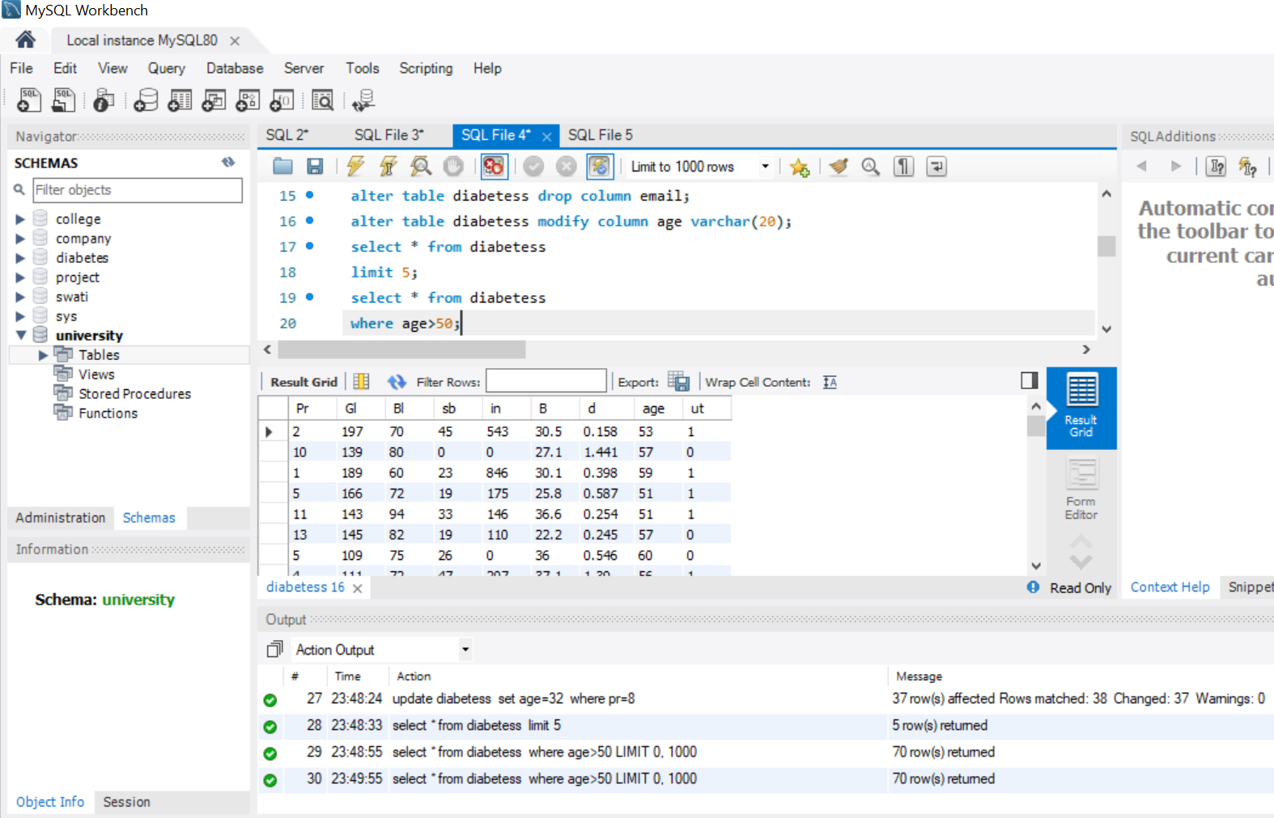
TO USE WHERE COMMAND
To display age more than 50

Slide 14
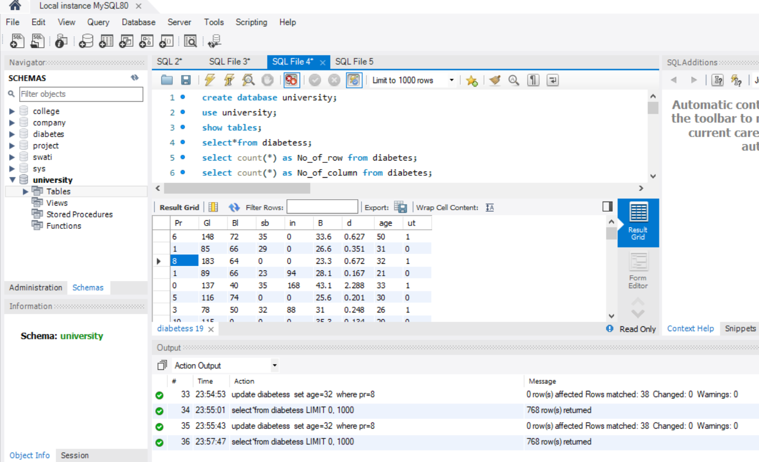
USE UPDATE COMMAND
Change the 32 age in the 8

Slide 15
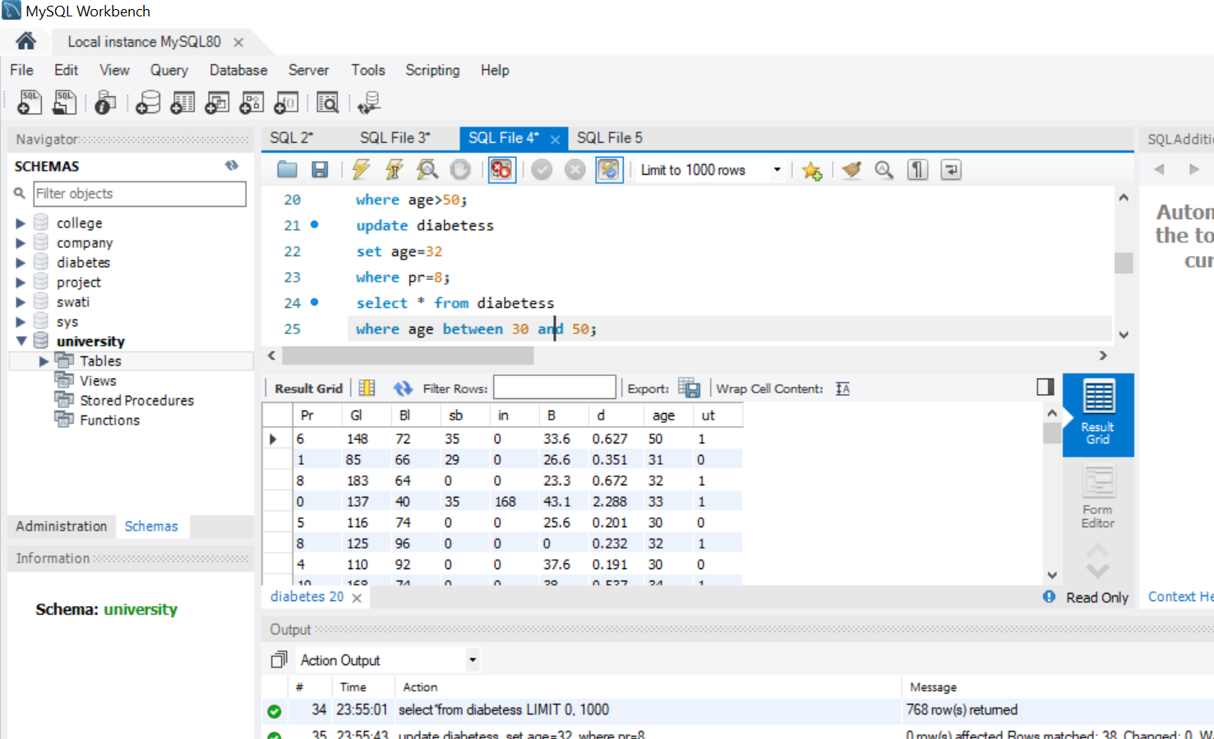
USE BETWEEN COMMAND
display only 30 to 50 age value

Slide 16
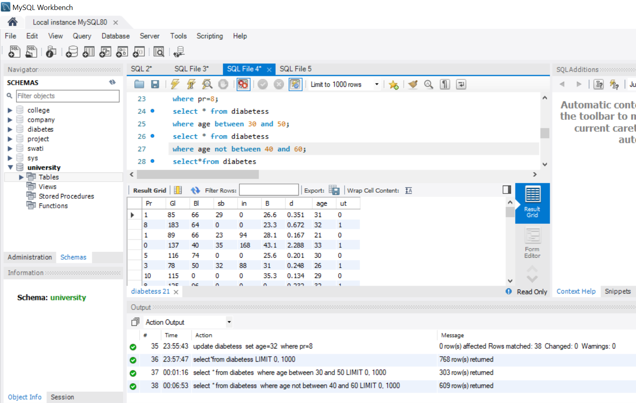
USE NOT BETWEEN COMMAND
Display under 40 age value

Slide 17
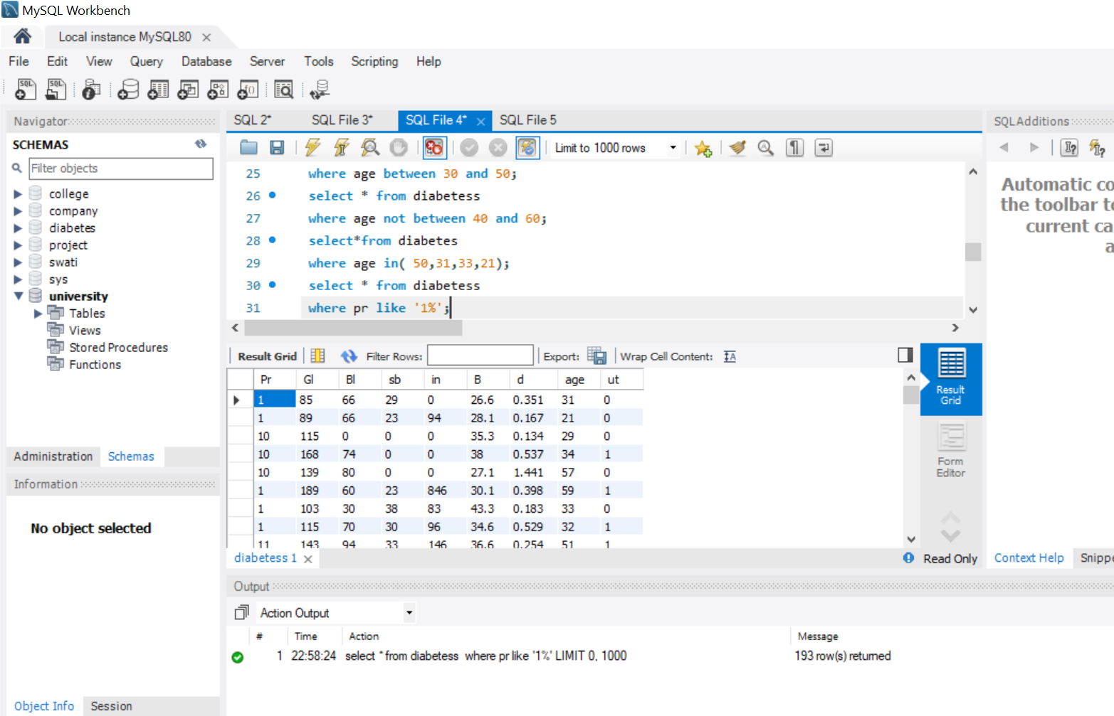
USE LIKE CAMMAND

Slide 18
CONCLUSION
We have to performed various filtering or analysis on diabetes dataset using SQL querris.
thank you!

